Slide 1
PROJECT TITLE: INDIA VS POLLUTION
PIP2001 Capstone Project
Review-0
Batch Number:
Under the Supervision of,
Ms. Akkamahadevi
Dr./Mr./Ms./Prof.
Professor / Associate Professor / Assistant Professor
School of Computer Science and Engineering
Presidency University
Roll Number | Student Name
20211CSE0492 | Konduru Harshitha
20211CSE0493 | Dalavai Geetha Sree
20211CSE0126 | Metta Siva Nanda Reddy
Name of the Program: CSE
Name of the HoD: Dr. Blessed Prince P/Dr. Robin Rohit/Dr.Asif Mohammed H.B
Name of the Program Project Coordinator: Mr. Amarnath J.L & Dr. Jayanthi. K.
Name of the School Project Coordinators: Dr. Sampath A K / Dr. Abdul Khadar A / Mr. Md Ziaur Rahman

Slide 2
Content
Problem Statement
Analysis of Problem Statement
Timeline of the Project
References

Slide 3
Problem Statement Number: PSCS136
Organization: CDK Global(India)pvt Ltd
Category (Hardware / Software / Both) : Software
Problem Description: Every day we come across several sources of pollution, polluting the very basics of our lives- Rivers, Land, Air and Noise. We know nothing about who/where to report it and how. We suggest an Innovative way to identify the sources of pollution in your area, get it prioritized through people votes, escalate it to the concerned authorities, keep a track of the progress and get notified of the actions taken. It will provide an End-2-End tool to battle pollution democratically partnering with Govt.
Difficulty Level: Complex

Slide 4
Analysis of Problem Statement
Technology Stack Components: Sustainable Development
Frontend:
React.js
HTML, CSS
JavaScript
Backend:
Node.js with Express.js
Python/Django
MongoDB/MySQL
Firebase

Slide 5
Analysis of Problem Statement (contd...)
Software and Hardware Requirements:
Operating System: Windows 10, macOS, Linux
Frameworks: React.js, Node.js/Express.js
Database: MongoDB, MySQL
Maps & Geolocations APIs: Google Maps API, OpenStreetMap
Version Control : GitHub/GitLab

Slide 6
Analysis of Problem Statement (contd...)
Key Functionalities:
User Reports: users can report sources of pollution by submitting information with geotagged locations, photos, and descriptions.
Voting System: Other users can vote to prioritize the most pressing pollution issues in their area.
Escalation to Authorities: Once a threshold is reached, the issue is automatically escalated to the appropriate government authority.
Progress Tracking: Users can track the progress of their reports and receive notifications about updates or actions taken.

Slide 7
Analysis of Problem Statement (contd...)
Notifications: Users and authorities receive updates on the status of the pollution report.
Data Dashboard: Admins and government bodies can monitor pollution data, track areas with the highest complaints, and prioritize actions.
Potential Challenges:
Data Validation: Ensuring that reports are genuine and not spam.
Authority Integration: Building partnerships with government bodies for escalations and tracking.
Real-time Notifications: Implementing effective, timely notifications about report status and actions taken.

Slide 8
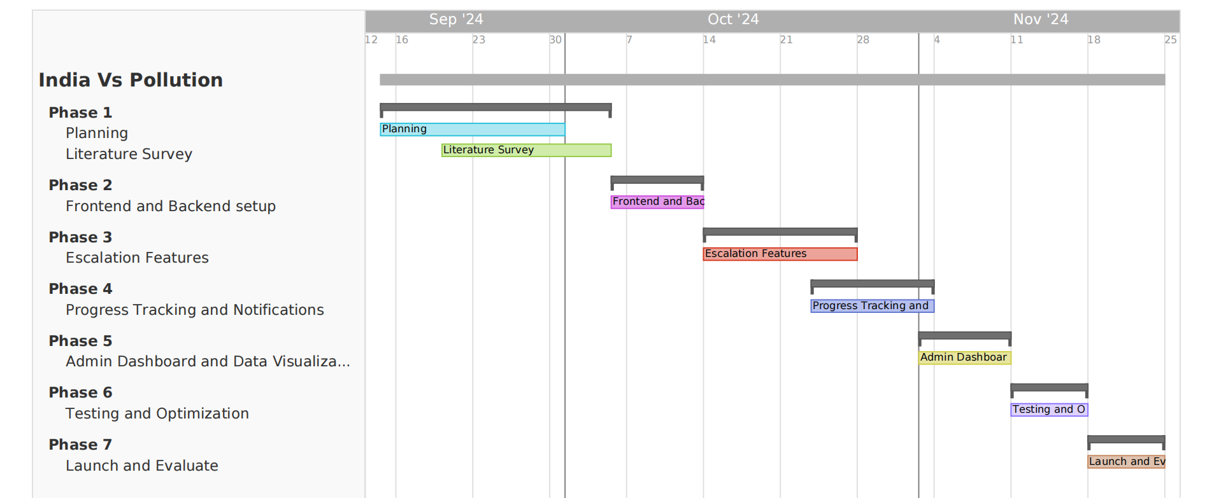
Timeline of the Project (Gantt Chart)

Slide 9
References (IEEE Paper format)
Wing-Kwong Wong, Nguyen Thi Thuy Hang, Meng-Yuan Tsai, Guan-Cheng Shi, and Yo-Chen Tsai, “Web Service and a Mobile App for Reporting Site Pollution and Other Features”, IEEE, 2021
Miriam A. Carlos-Mancilla, José Raúl Castañeda Rosas, Monica Lozada-Muñoz, Omar Alí Zatarain Durán, Yehoshua Aguilar Molina, Rodolfo Omar Domínguez García, and Miriam Gonzalez Dueñas, “Development of an intelligent platform for obtaining environmental data”, IEEE, 2022
Rida Kanwal, Warda Rafaqat, Mansoor Iqbal, and Song Weiguo, “Exploratory Analysis of the Relationship between Wildfire Properties and Air Pollution in Chine under Sustainable Development”, IEEE, 2023

Slide 10


